Slide 1
Our Country
India is a vast country.
Seventh largest country.
Second most populated country in the world.
It is a subcontinent.
The official name for the country is Republic of India.
The citizens of India are known as Indians.
There are two other names for India – Bharat and Hindustan.

Slide 2
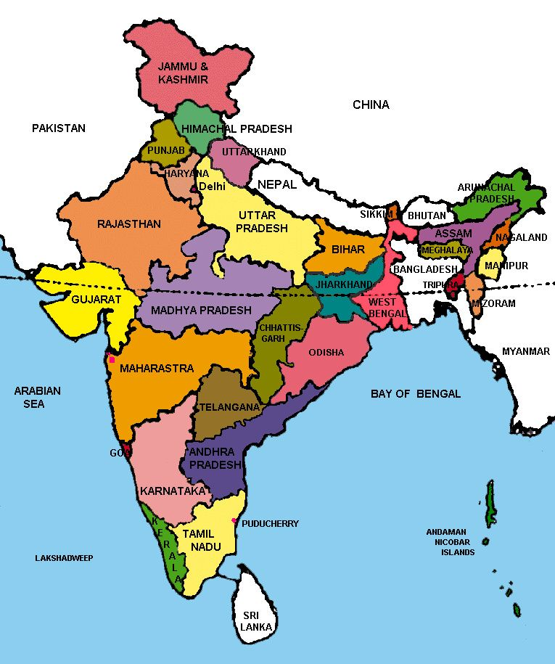

Slide 3
States of India and their Capitals
India has twenty-nine states which extend from Jammu and Kashmir in the north to Kerala in the south, and from Gujarat in the west to Arunachal Pradesh in the east.
Arunachal Pradesh, Assam, Meghalaya, Manipur, Mizoram, Nagaland and Tripura together are called ‘ Seven Sister States.’
Telangana is the youngest state, formed in 2014.

Slide 4
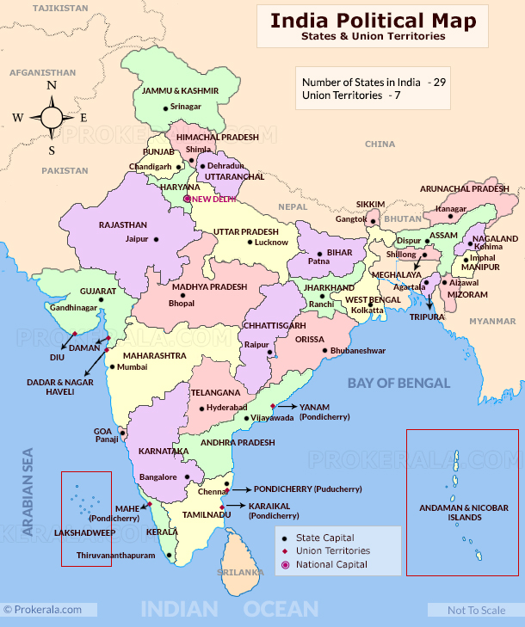

Slide 5
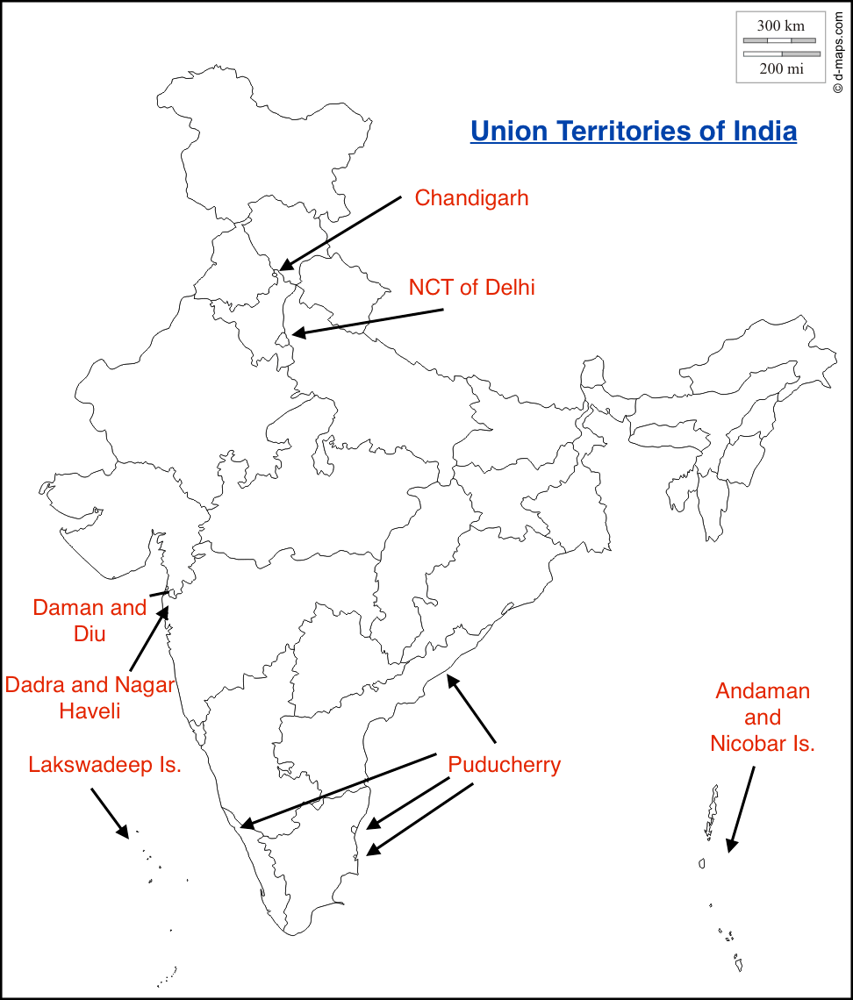
India has seven Union Territories.
Delhi is also a union territory.
Most populated state is Uttar Pradesh.

Slide 6
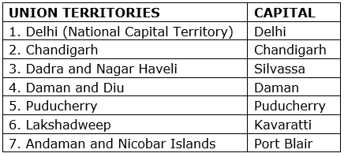
Andaman and Nicobar Islands is the largest union territory of India
Lakshadweep is the smallest union territory.

